Slide 1
Dormcheck
Simple. Secure. Smart.
Computer Science Engineering project work - N-LA02
/ Laszlo Toth
By
Attila Hoki, Armand Koltai, Mark Kovacs

Slide 2





Extended 3 – Tier Architecture
Presentation
Tier
Logic Tier
Data Tier
Client
Embedded
System
Server
Database
Microcontroller

Slide 3
High Level Overview
FRONTEND
NFC READER
MICROCONTROLLER
(ARDUINO)
HTTP POST
APPLICATION SERVER
SPI
HTTP GET
BUZZER
NEOPIXEL
RELAY
RELATIONAL
DATABASE
BACKEND

Slide 4
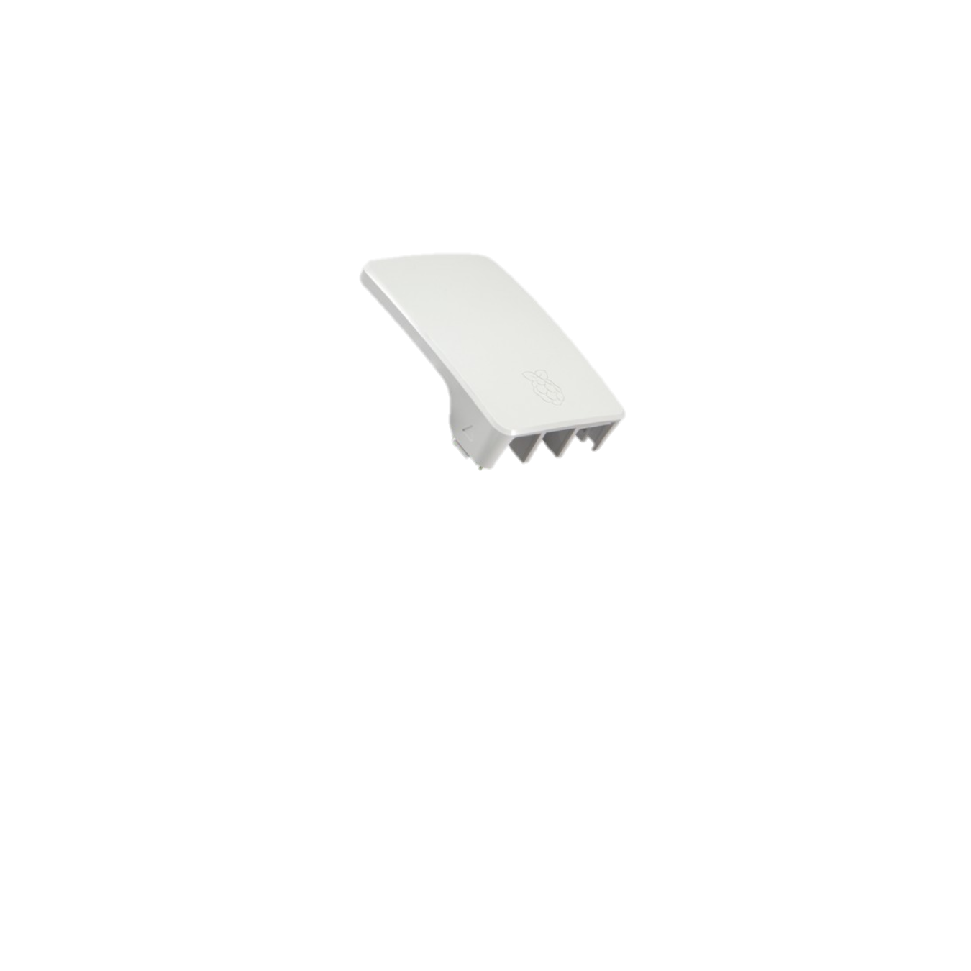
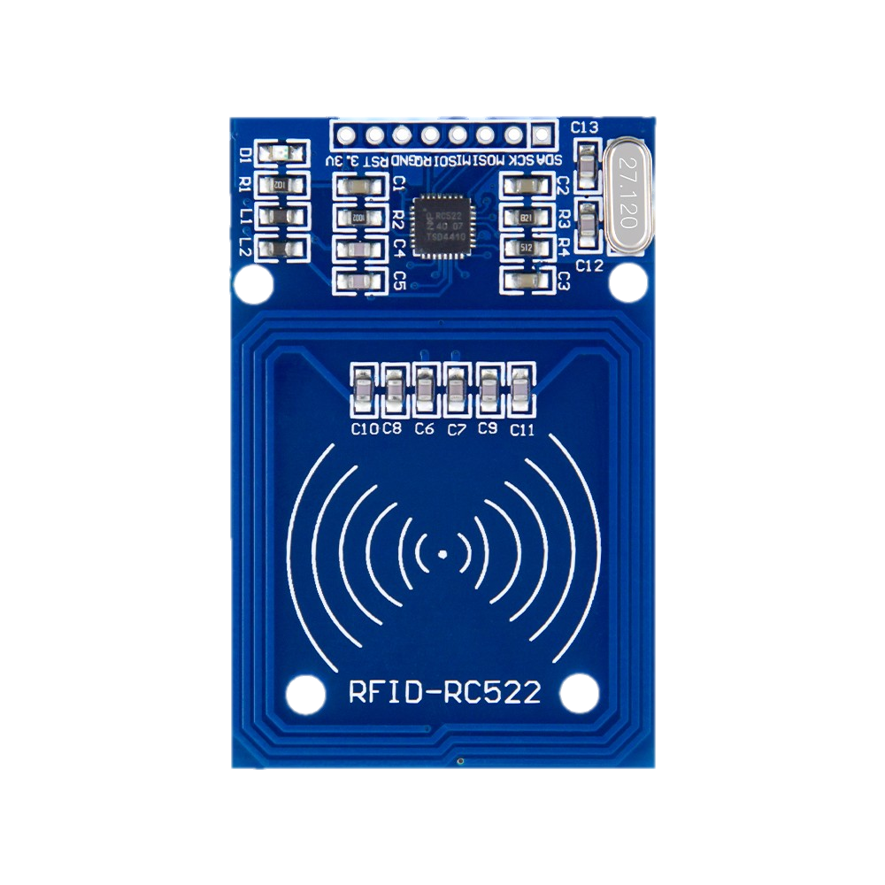
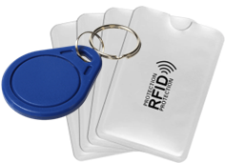
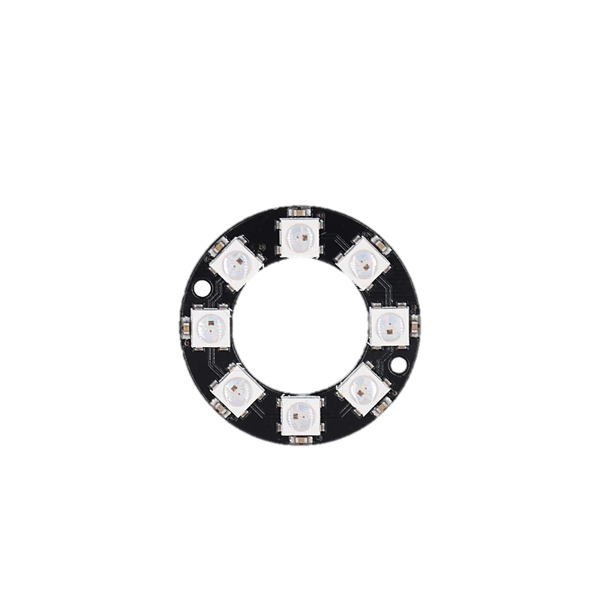
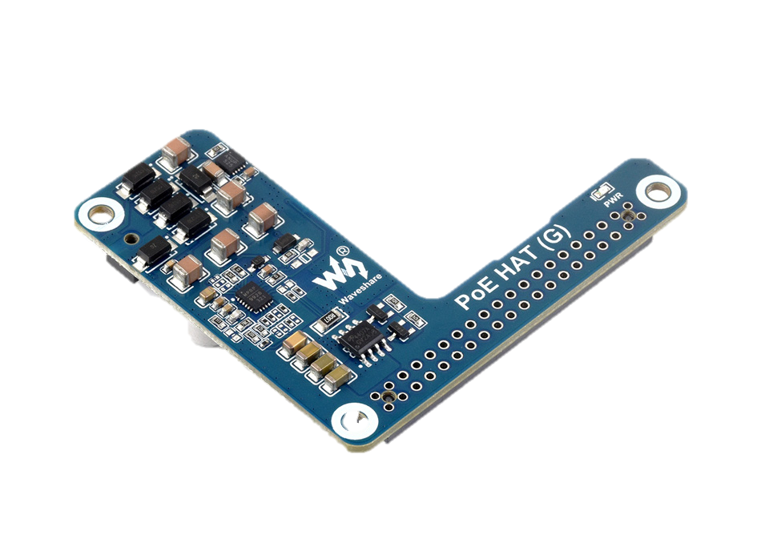
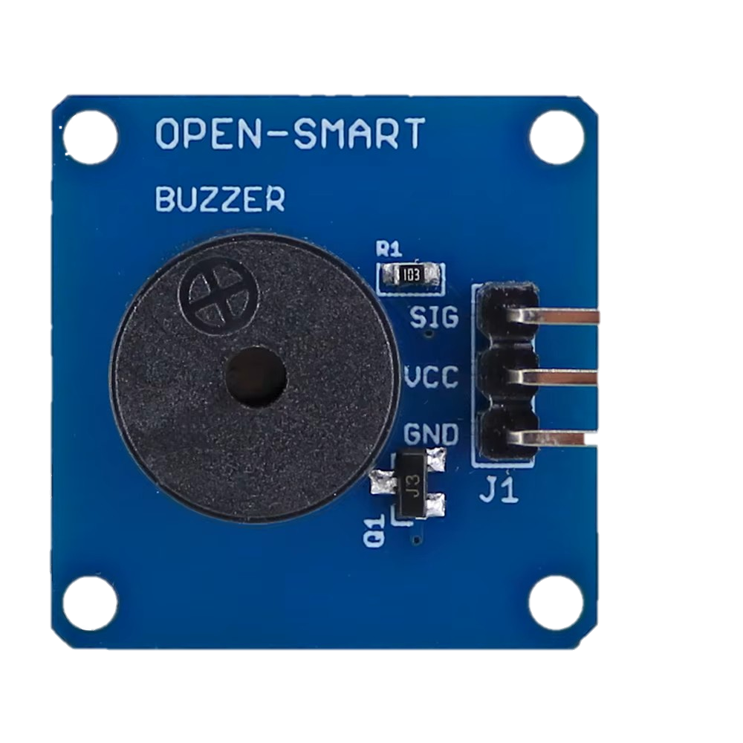
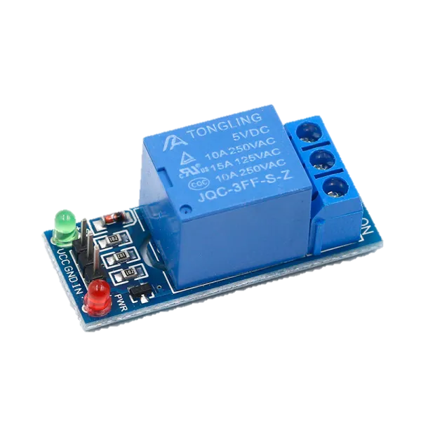
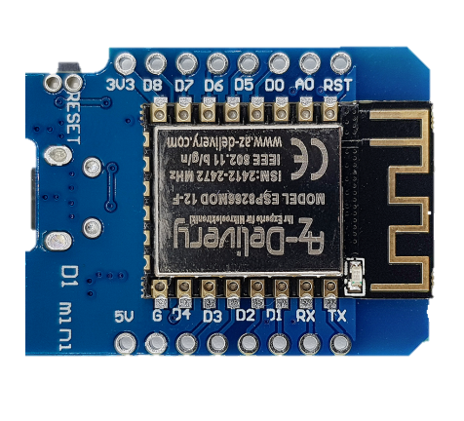
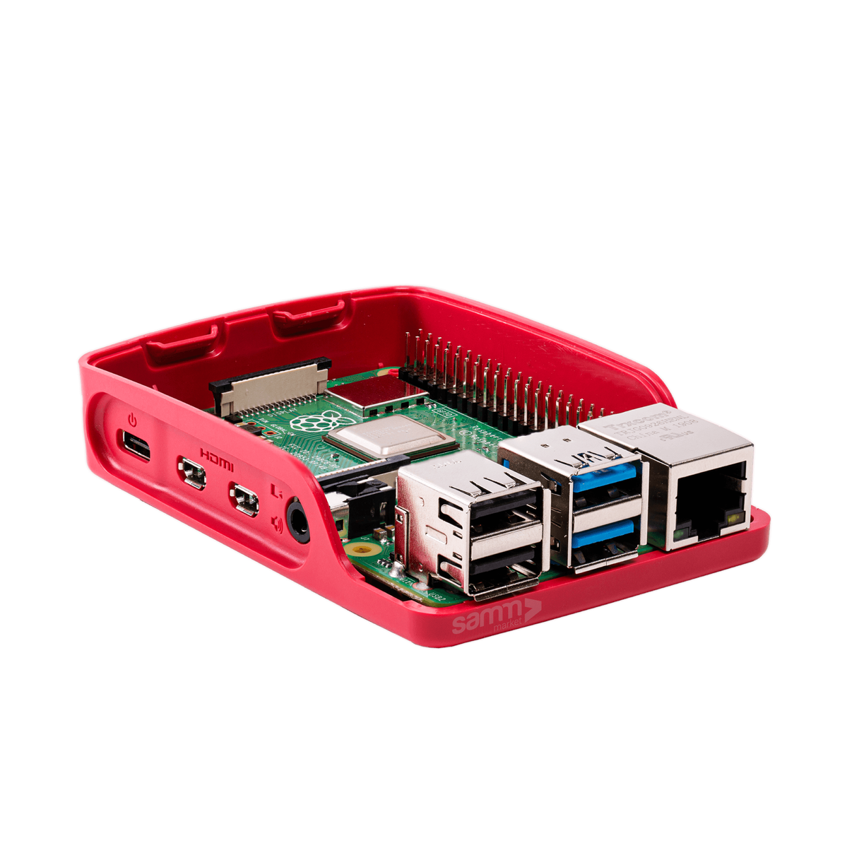
Hardware topology
POST
Optical
feedback
Original case
Audio
feedback
PoE Hat
Card reader
GET
Lock
opener
Raspberry pi 5
8Gb
Controller
The Server
The Client node

Slide 5












"Production ready"
Push. Automate.
Deploy
Access. Monitor.
dormcheck.duckdns.org

Slide 6
Dormcheck
Sprint Review 3
Computer Science Engineering project work - N-LA02
/ Laszlo Toth
By
Attila Hoki, Armand Koltai, Mark Kovacs

Slide 7
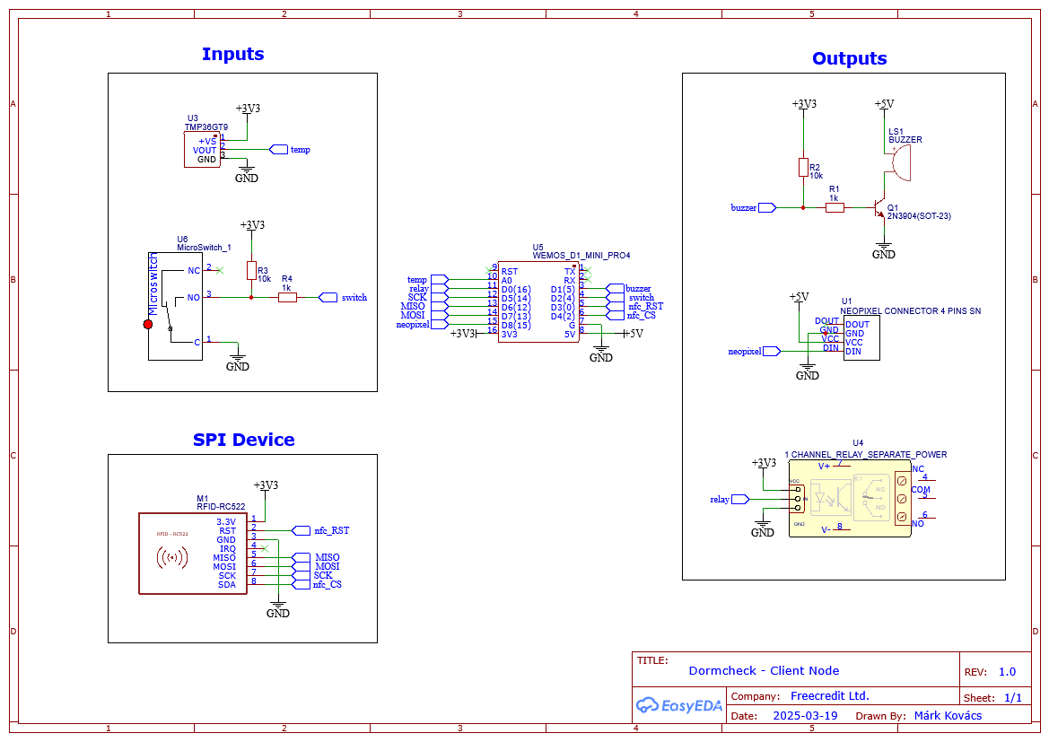
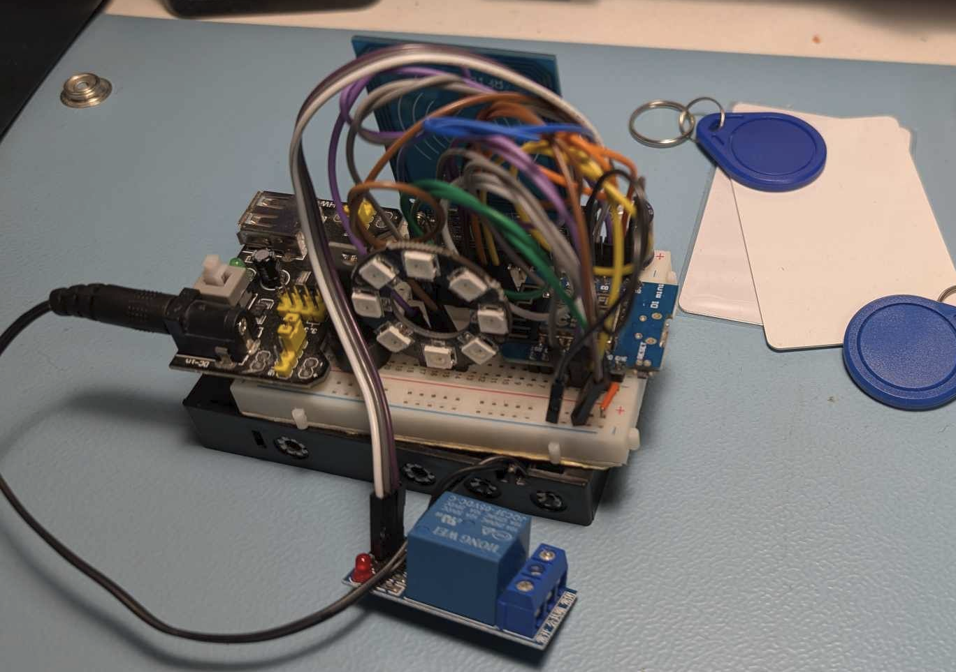
Client Node Hardware
Schematic design
Built hardware prototype

Slide 8
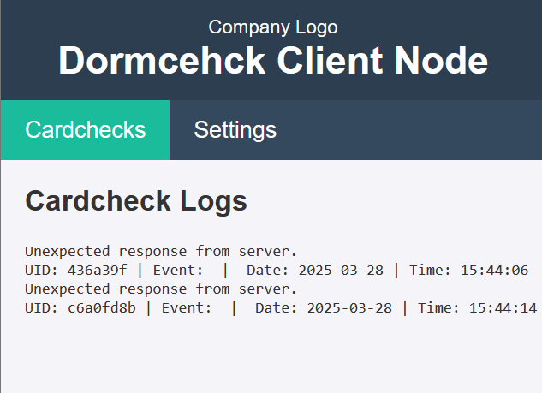
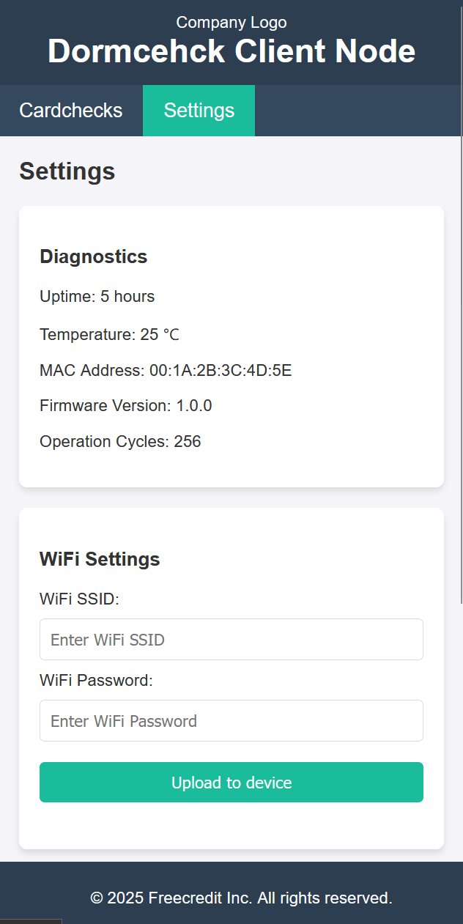
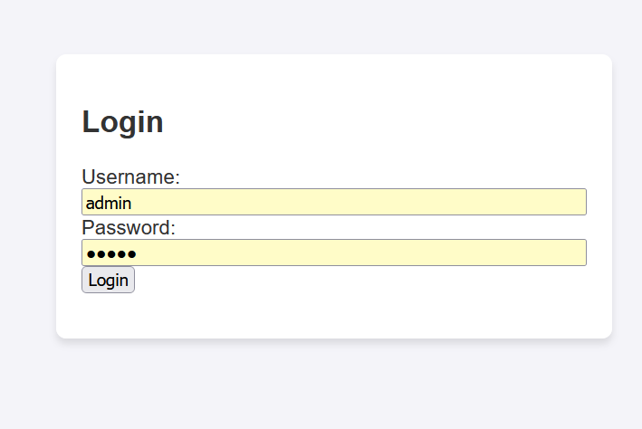
Client webserver features
Authentication
View last 30 card checks and system responses
Access Client device’s self-diagnostic data
Change wi-fi connection
Upload new firmware binary over the air
Override door lock in emergency scenarios

Slide 9

Data Management Requirements
User Management
Card and Assignment Details
Room and Building Information
Entry Monitoring
User Activity Logging
Guest Reception (*)
Service and Subscription Management (*)

Slide 10
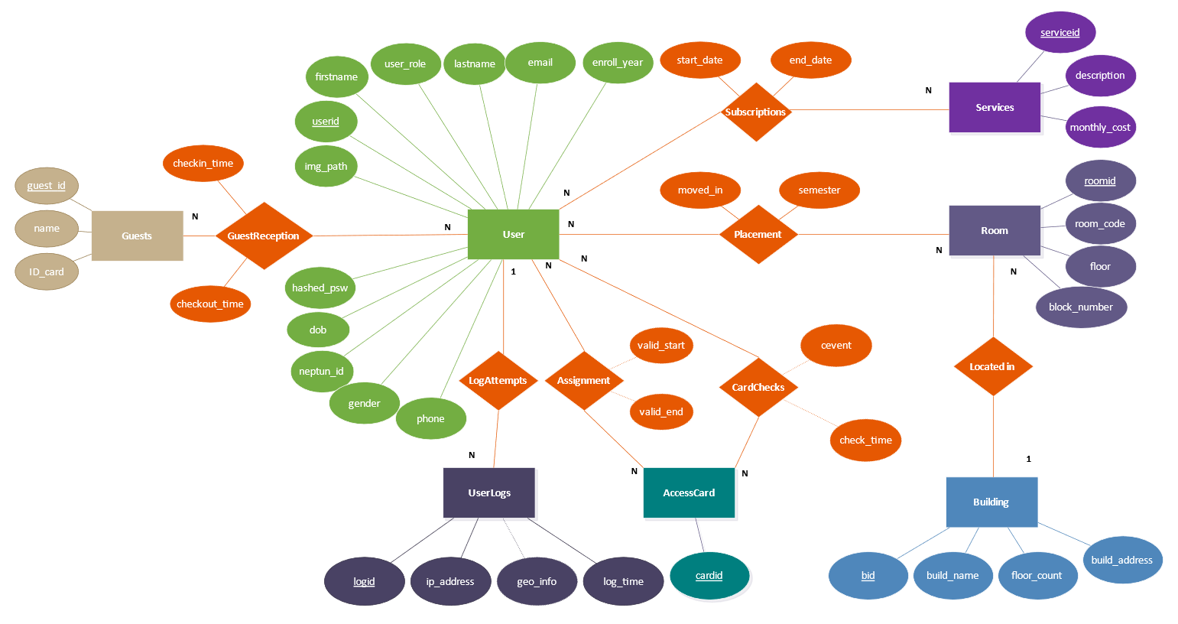
Entity-RelationShip Diagram

Slide 11
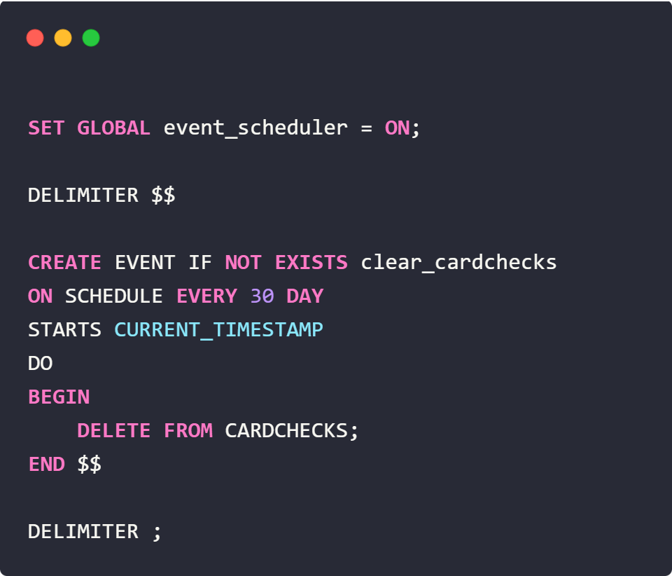
Data Management Requirements
High-frequency data logging in CardChecks
Increased storage consumption and backup size
Potential increase in query execution time
↓
Automated purge implemented via MySQL Event

Slide 12
UI Planning

